Slide 1
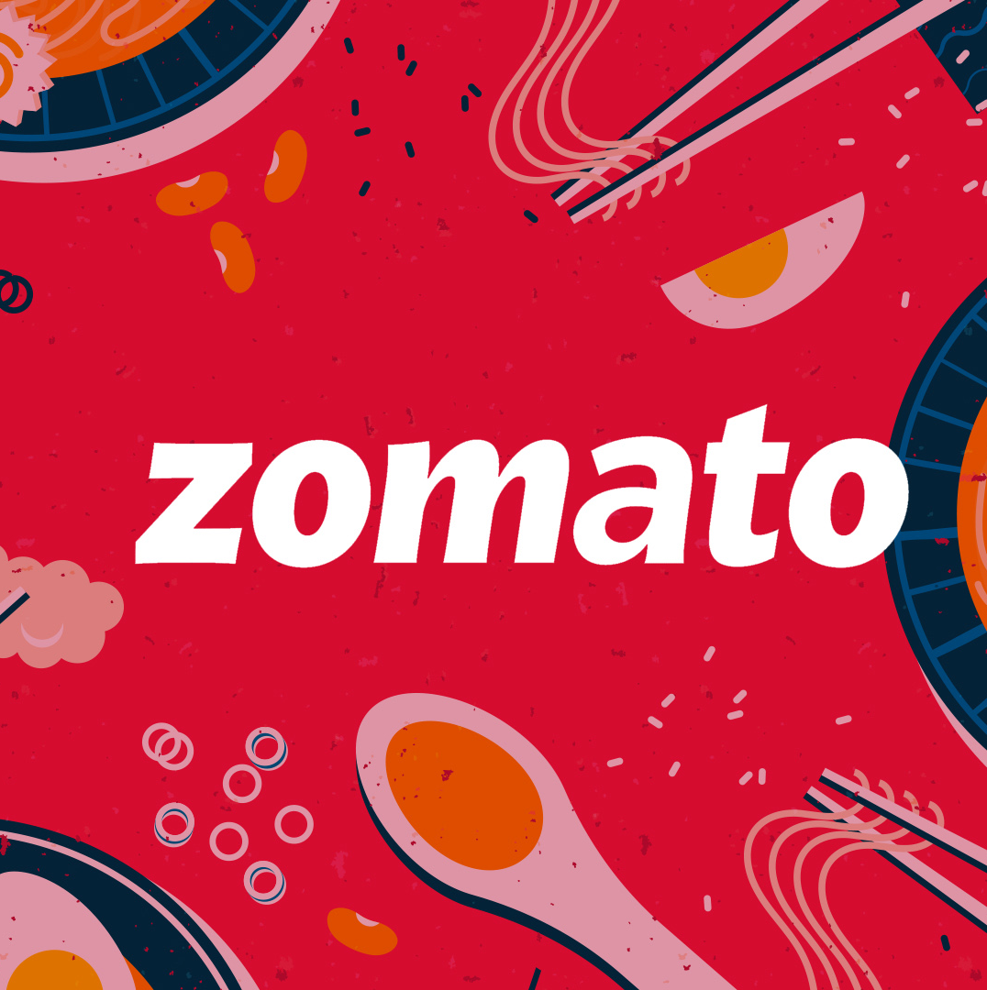
Zomato Restaurant Data Analysis
Zomato is an Indian multinational restaurant aggregator and food delivery company. It was founded by Deepinder Goyal and Pankaj Chaddah in 2008.
Key Contributors
1. SUBHAM LAHA
2. BIJOY SOME
3. SK MONIRUL ISLAM
Guidance by
Dr. Sayantani Roy Choudhury

Slide 2
OBJECTIVE
Zomato’s global presence
Which is the most preferred cuisine in India?
How do ratings and cost for two vary across services provided ?
What are the effects of number of cuisines offered on Zomato’s business?

Slide 3
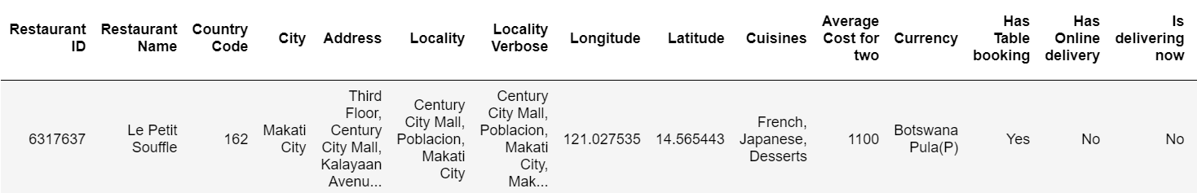
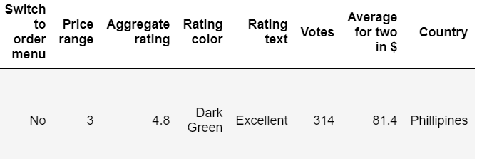
DATA SOURCE
Link
Format
Tool used
Language used
Nos of records
The data is in csv format.
Python (Pandas)
https://github.com/himanshu0195/Zomato-EDA/blob/main/zomato.csv
Jupyter Notebook , Tableau Desktop, Power BI
Initially, it has 9552 nos of records.

Slide 4



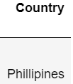



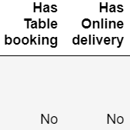
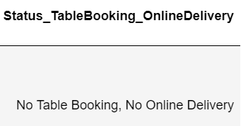

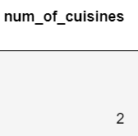
METHODOLOGY
Data Collection
Feature Engineering
Data Cleaning
Performing EDA
Feature Engineering
Conclusion

Slide 5
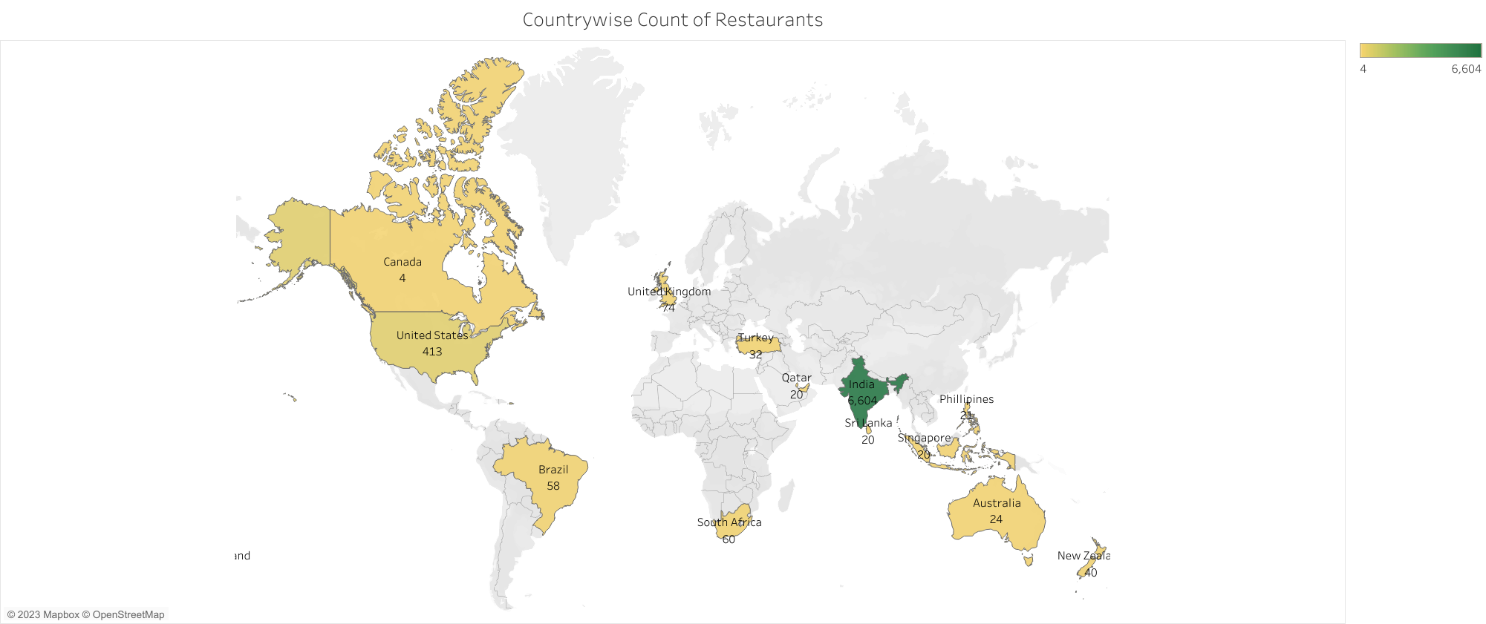
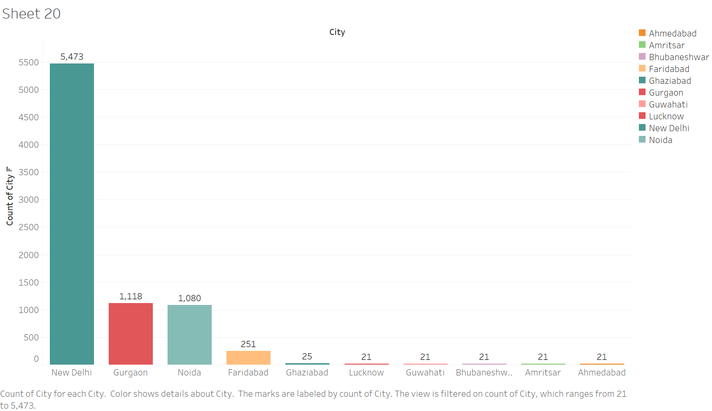
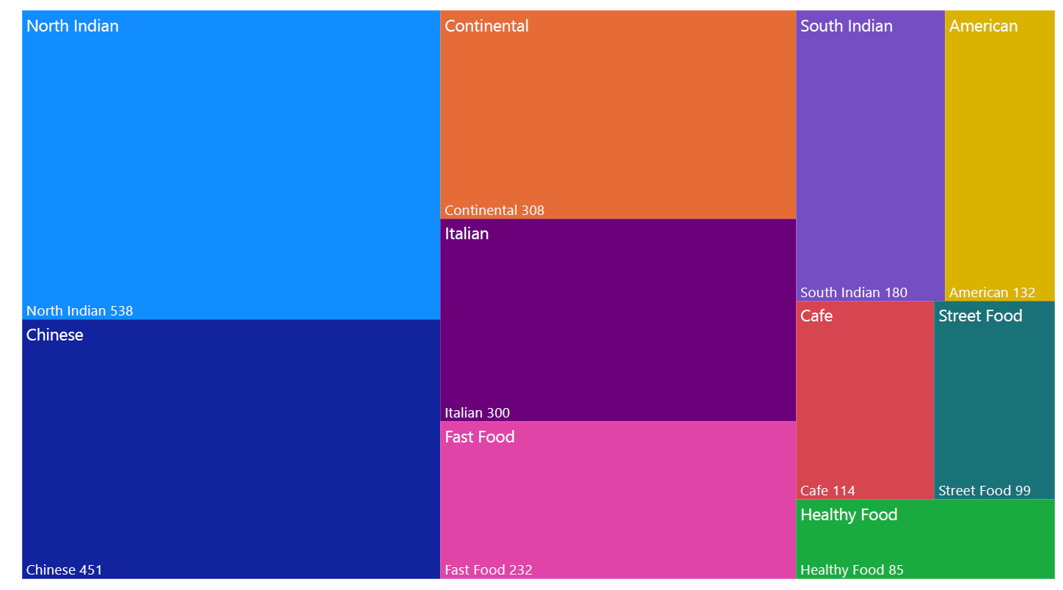
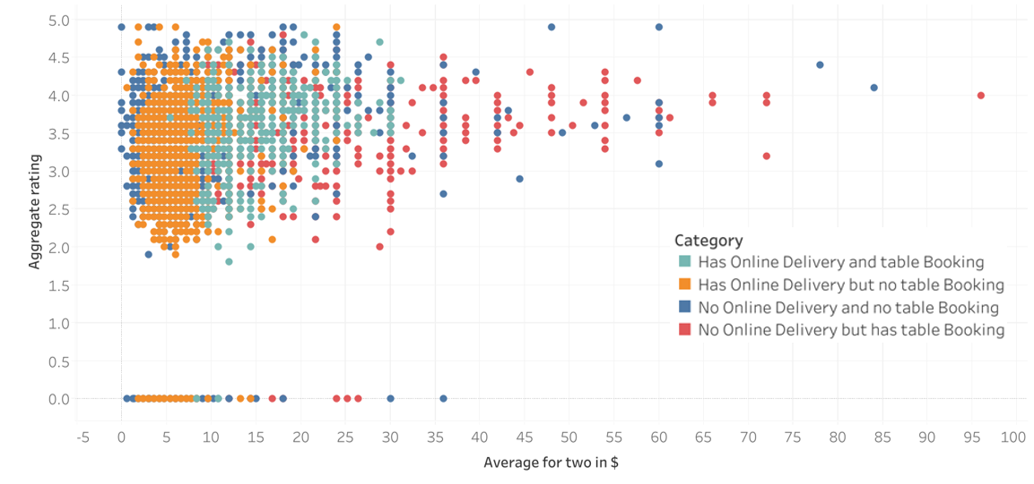
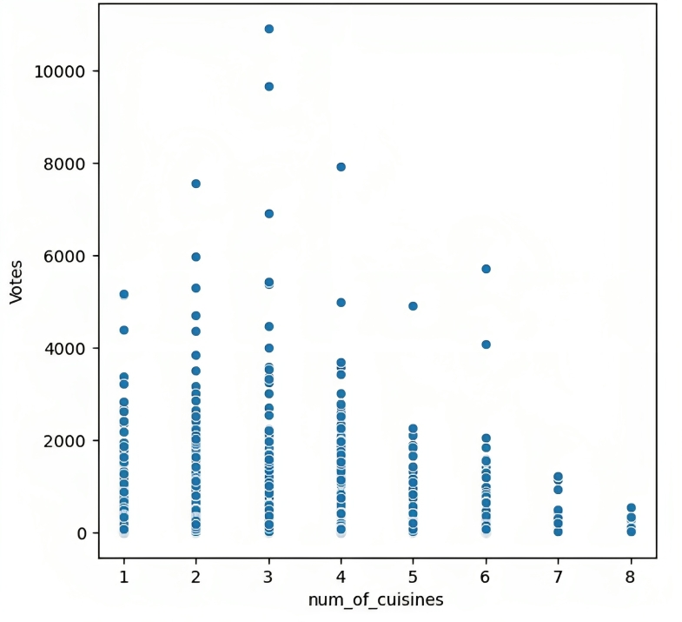
EDA

Slide 6
INTERPRETATIONS
Zomato India has 6604 restaurants, followed by USA with 413 restaurants.
1
New Delhi has highest no of restaurants in India.
2
Most preferred cuisine in India is North Indian.
3
Restaurants with higher ratings having higher cost for two.
4
India offers 71 variety of cuisines
5

Slide 7
CONCLUSIONS
Most of Zomato's business is concentrated in India, no other country even comes close. Even within India, there is a huge bias. Most of Zomato's business is concentrated in and around New Delhi. The popularity of the North Indian Cuisine also supports the above inference.
1
It can be noted that a majority of restaurants in India are priced at an average below Rs.2000. This proves that there are far too many people who spend an average of Rs.2000 or less for two. It can also be noted that most restaurants that are priced below Rs.1000-Rs.1200 range, offer online order and delivery services, but no prebooking of tables. And it starts becoming the opposite, if we start moving up the price range.
2
Zomato can incentivize the process of rating given so that other people would find suitable restaurants based on the ratings.
3
The optimum number of cuisines to be offered by restaurants is around 2-5 Cuisines. Maximum number of people prefer going to restaurants offering 2-5 Cuisines, which also supports the above inference.
4
5
Zomato can expand worldwide at places where avg price data is on a higher side for other countries so it can maximize the commission from the restaurants.

Slide 8
THANK YOU

